Slide 1
UNIT I

Slide 2
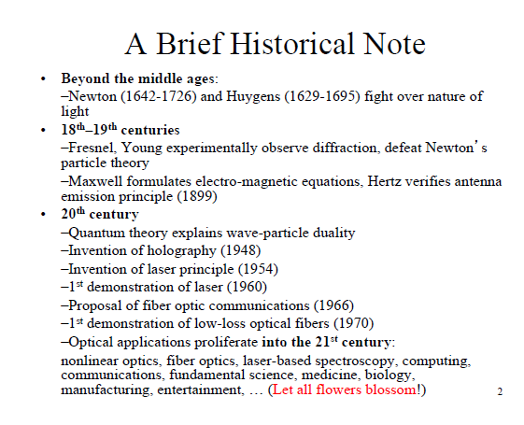

Slide 3
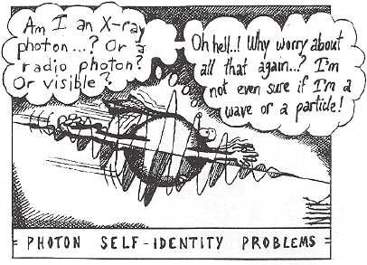
NATURE OF LIGHT
Concept —Light can be explained as
  Rays: using Optical
  Geometry
  Waves: using
  Electromagnetic Theory
  Photons: using Photoelectric
  Effect
  ?: using Quantum Mechanic
We will need
  Optical Geometry → to explain light propagation
  Electromagnetic Theory → to understand spectrum
  Photoelectric Effect → to show lasers and photodetectors
Notes:
PESO
- Menos de la décima parte que coaxial
INCONVENIENTES
- No es capaz de llevar la alimentación (como hace el coaxial)

Slide 4
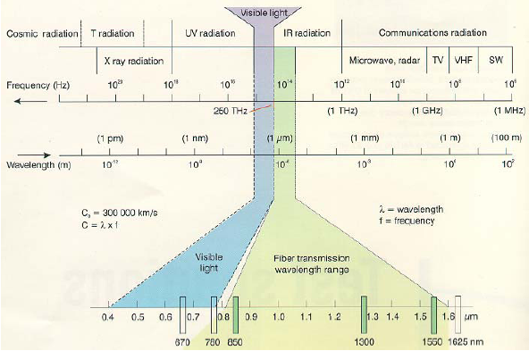
NATURE OF LIGHT
Spectrum —Light as a wave
Notes:
PESO
- Menos de la décima parte que coaxial
INCONVENIENTES
- No es capaz de llevar la alimentación (como hace el coaxial)

Slide 5
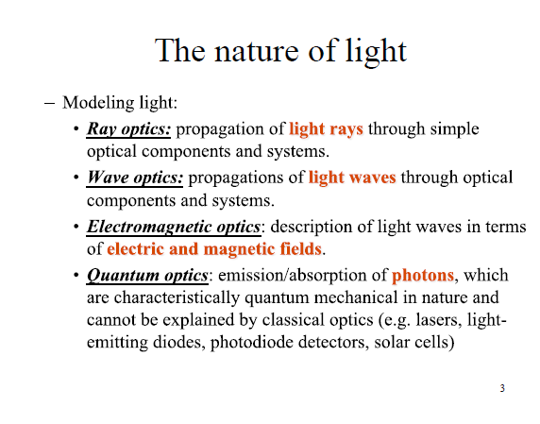

Slide 6
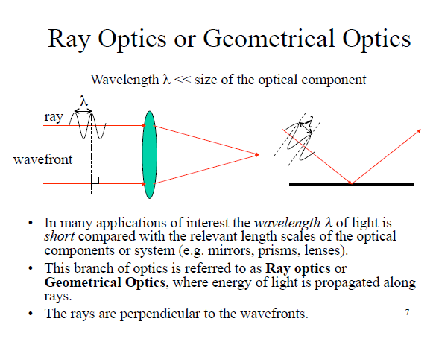

Slide 7
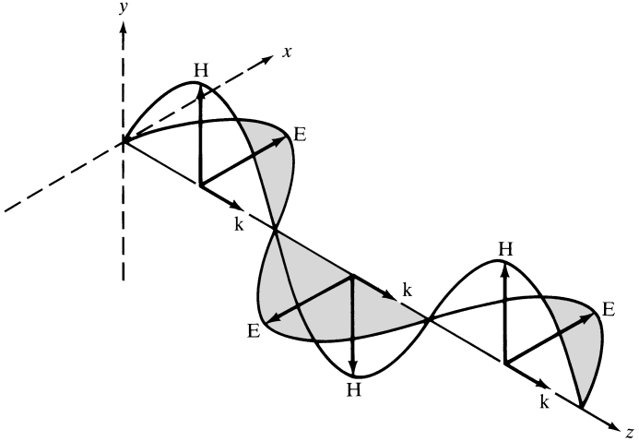
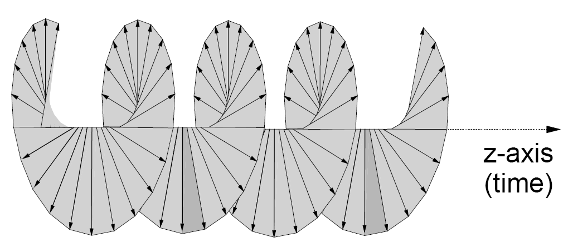
NATURE OF LIGHT
Polarization —Light as a wave
  An electromagnetic wave has electric (E) and magnetic (H) fields. They are perpendicular
  The orientation and phase of E defines the polarization (linear, circular or elliptical)
Circular polarization
Notes:
PESO
- Menos de la décima parte que coaxial
INCONVENIENTES
- No es capaz de llevar la alimentación (como hace el coaxial)

Slide 8
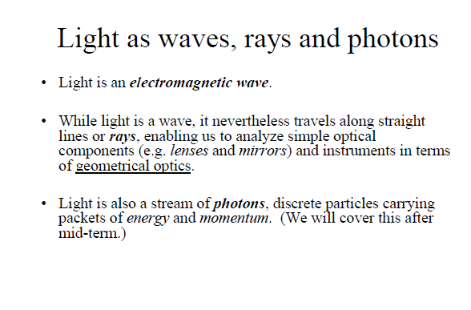

Slide 9
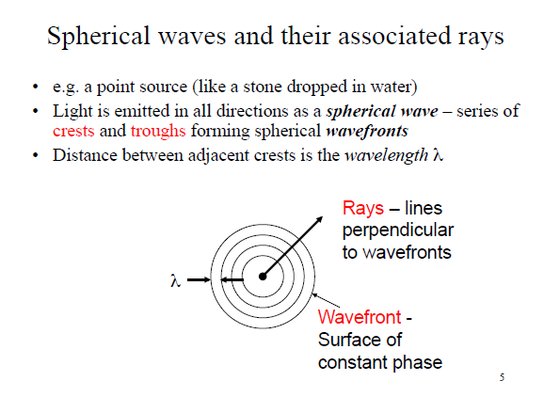

Slide 10
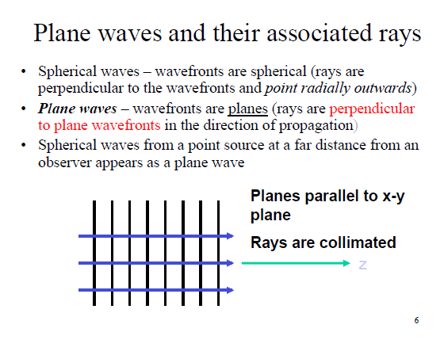

Slide 11
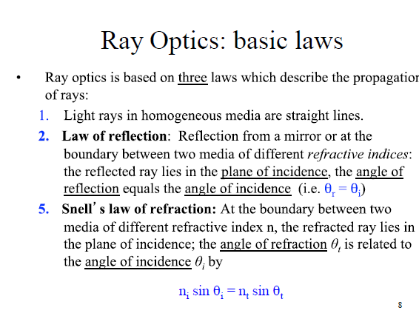

Slide 12
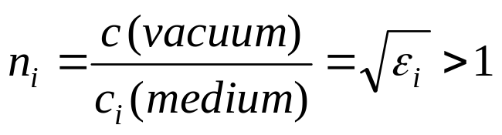
REFRACTIVE INDEX
Refractive Index of a medium i
  Measures how much the speed of light is reduced
  “n” typical value: 1.5
  ε_{i}: material’s relative permittivity
    REAL in fiber (dielectric)
    ε_{i} = ε’ – j·ε’’ ; ε’’ negligible in a dielectric
  c ≅ 3·10⁸ m/s, light speed in vacuum
    Maximum speed of any physical phenomena
    c = 299,792,458 m/s (set by definition)
Notes:
PESO
- Menos de la décima parte que coaxial
INCONVENIENTES
- No es capaz de llevar la alimentación (como hace el coaxial)

Slide 13
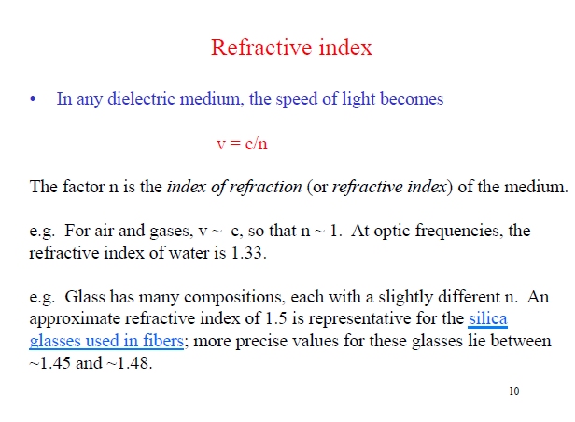

Slide 14
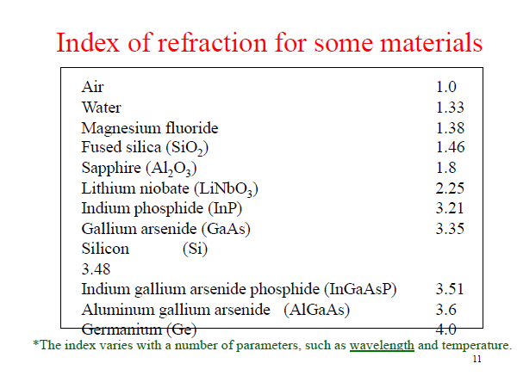

Slide 15
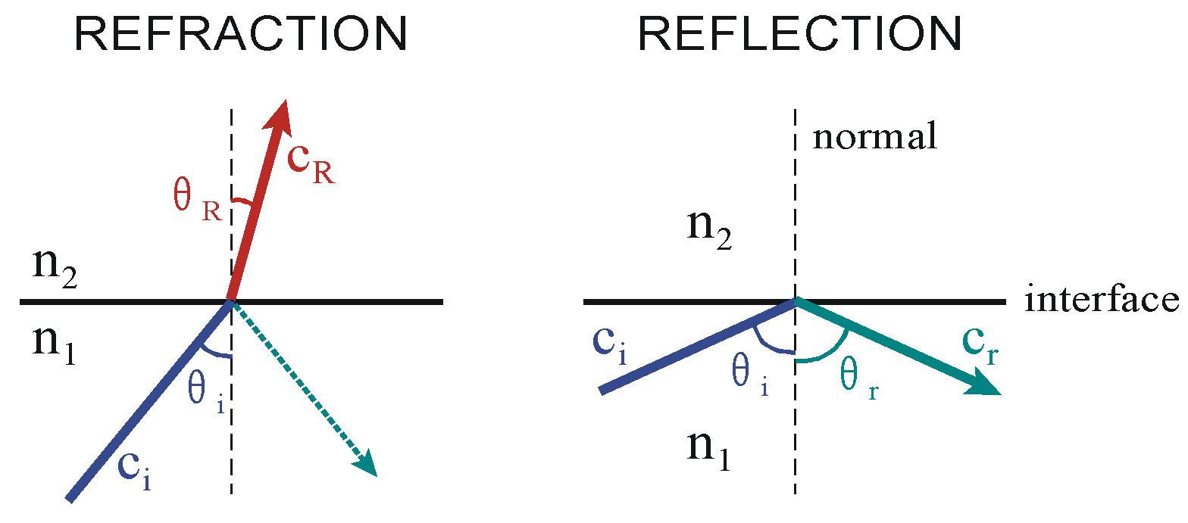
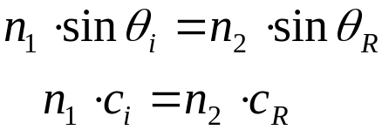
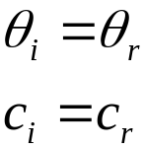
REFRACTIVE INDEX
Snell’s Laws (Optical Geometry)
  Light = rays
  Light propagation → straight-line (homogeneous medium)
(In refraction
there is always
a reflected ray)
Notes:
PESO
- Menos de la décima parte que coaxial
INCONVENIENTES
- No es capaz de llevar la alimentación (como hace el coaxial)

Slide 16
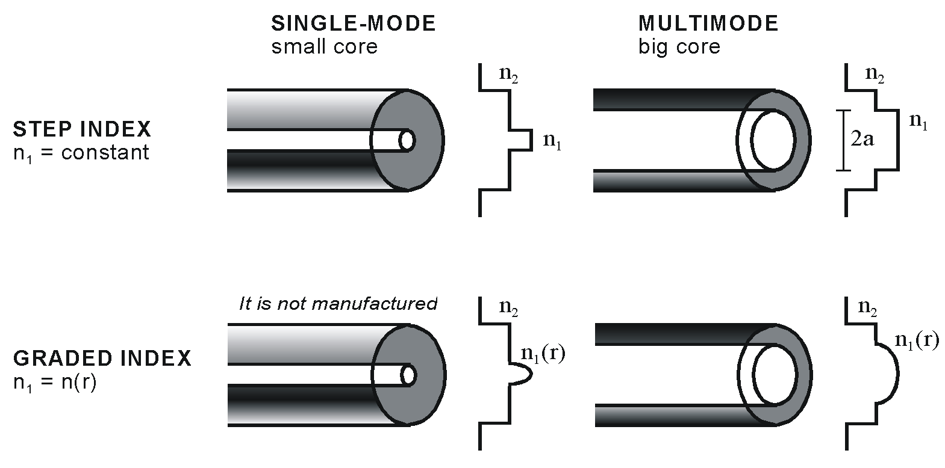
WAVES
Fiber types
Notes:
PESO
- Menos de la décima parte que coaxial
INCONVENIENTES
- No es capaz de llevar la alimentación (como hace el coaxial)

Slide 17
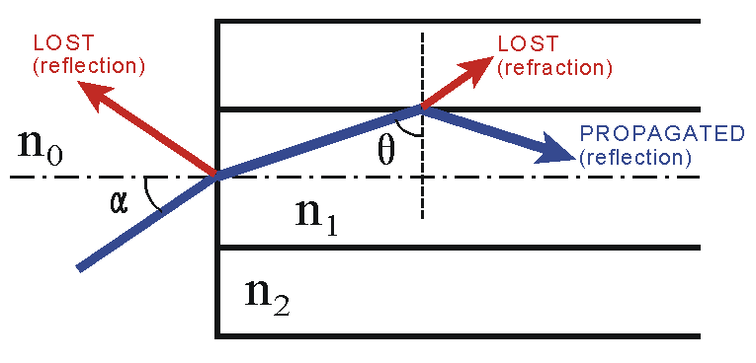
RAYS
Ray Theory
  Core: carries light
  Cladding: confines light into the core
  In order to propagate light
    Air/core interface: refraction (lighting horizontally)
    Core/cladding interface: reflection (n₁ > n₂)
Air:
n₀ ≈ 1
Notes:
PESO
- Menos de la décima parte que coaxial
INCONVENIENTES
- No es capaz de llevar la alimentación (como hace el coaxial)

Slide 18
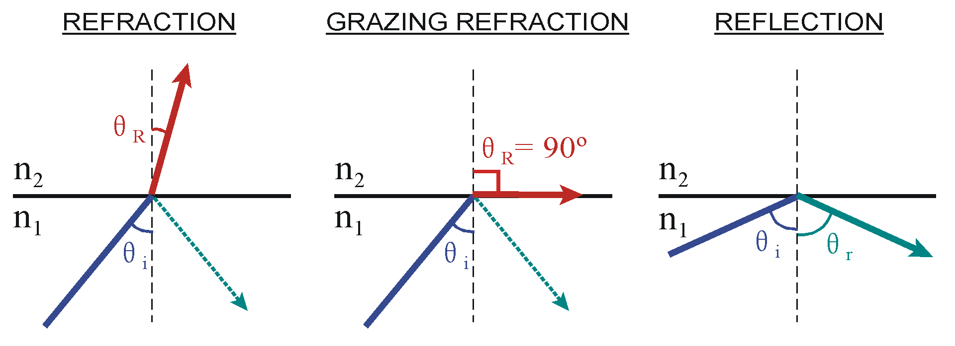
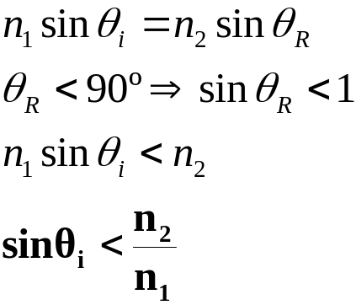
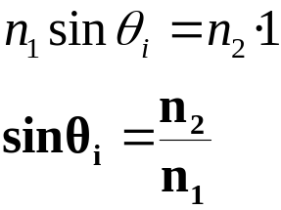
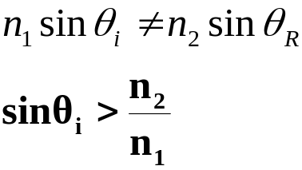
RAYS
Snell’s Laws —core/cladding interface
Notes:
PESO
- Menos de la décima parte que coaxial
INCONVENIENTES
- No es capaz de llevar la alimentación (como hace el coaxial)

Slide 19
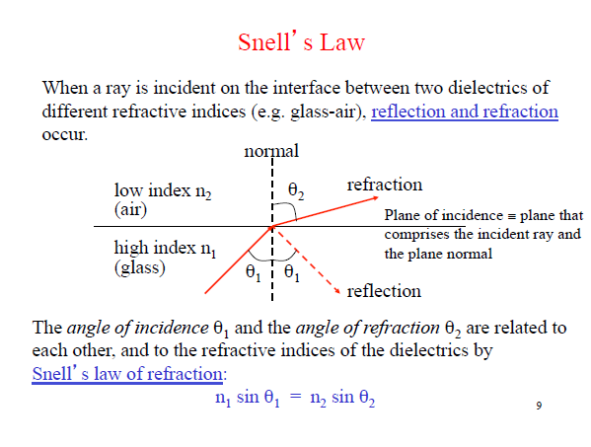

Slide 20
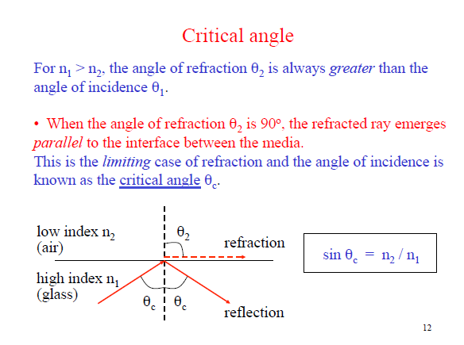

Slide 21
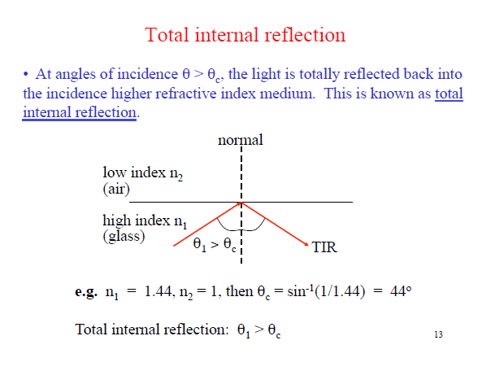

Slide 22
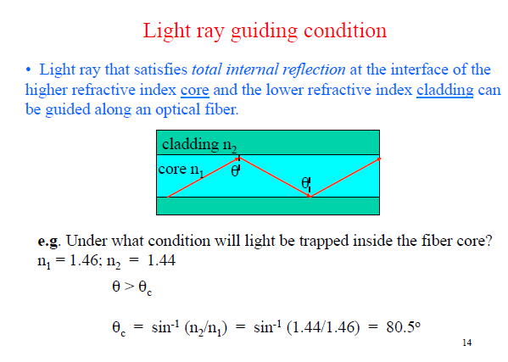

Slide 23
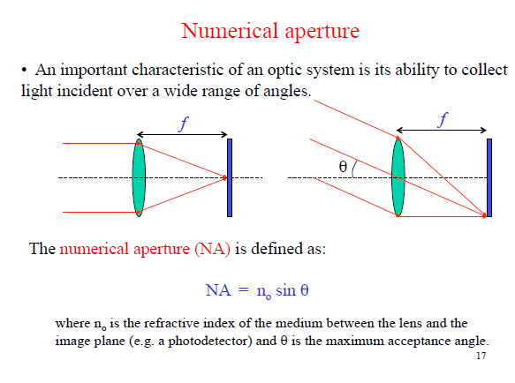

Slide 24
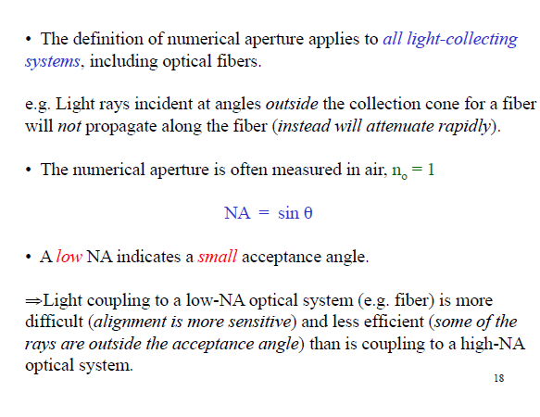

Slide 25
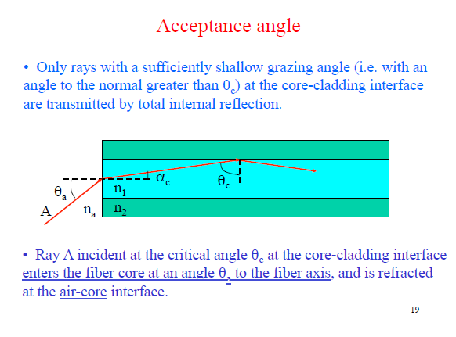

Slide 26
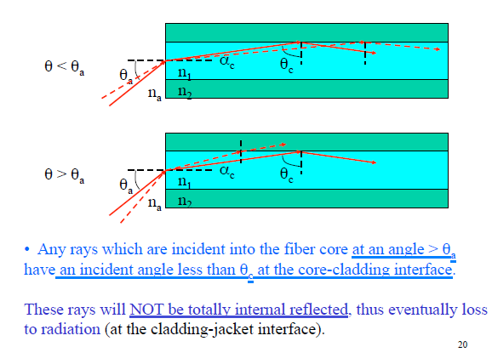

Slide 27
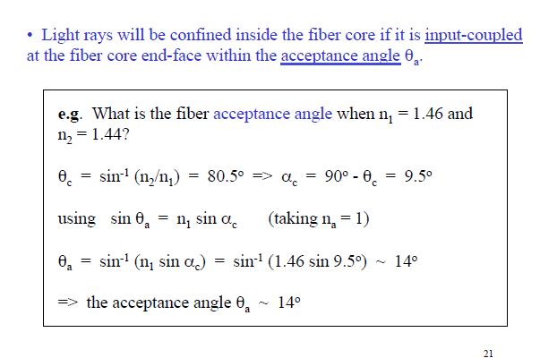

Slide 28
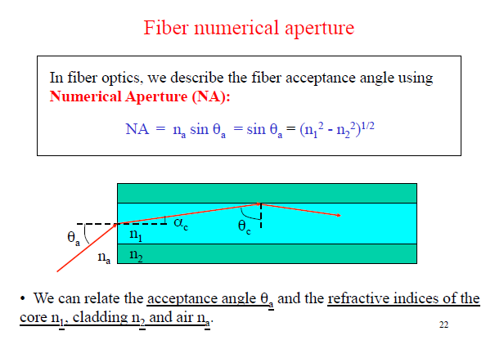

Slide 29
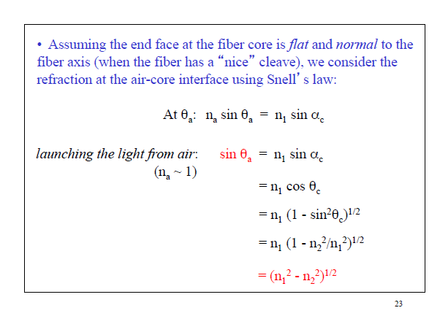

Slide 30
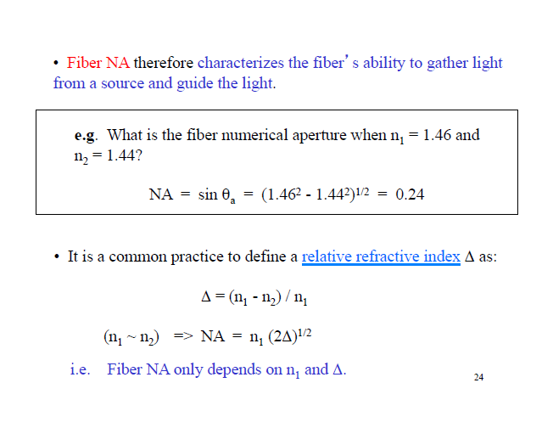

Slide 31
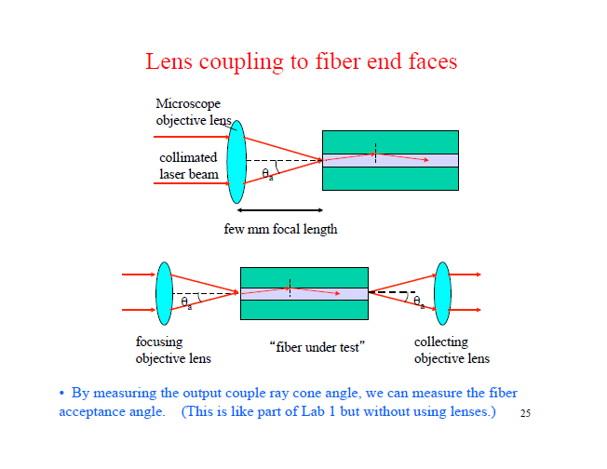

Slide 32
FIBER STRUCTURE
What is a fiber?
  Dielectric waveguide (usually cylindrical)
    An only wire
    It does not carry electricity
  Carries light (inside)
  Tiny size (like a human hair)
  Can transmit high data rates
AS FIBER HAS SO MANY PROS, OPTICAL COMMUNICATIONS ARE USUALLY MADE VIA FIBER
Notes:
PESO
- Menos de la décima parte que coaxial
INCONVENIENTES
- No es capaz de llevar la alimentación (como hace el coaxial)

Slide 33
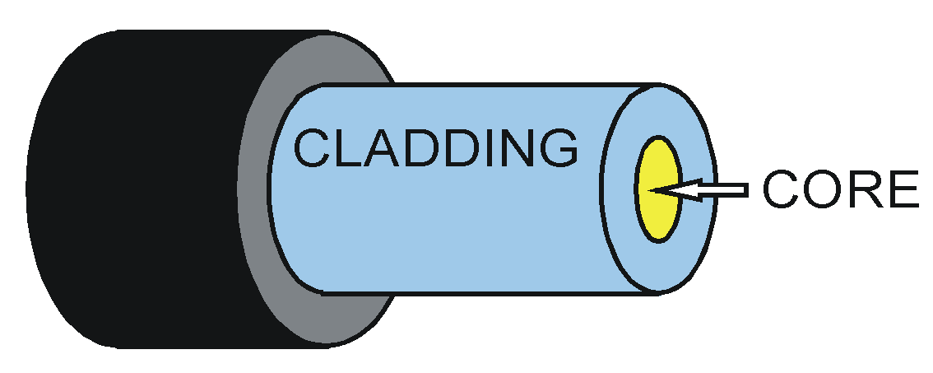
FIBER STRUCTURE
Structure
  Core: doped SiO₂
    Carries the light (most of it)
    Typical values: 8-10; 50; 62.5 μm ∅ (diameter)
  Cladding: pure/doped SiO₂
    Confines light into the core (like a mirror)
    Typical values: 125 μm ∅
  (Coating: outer protection)
Notes:
PESO
- Menos de la décima parte que coaxial
INCONVENIENTES
- No es capaz de llevar la alimentación (como hace el coaxial)

Slide 34
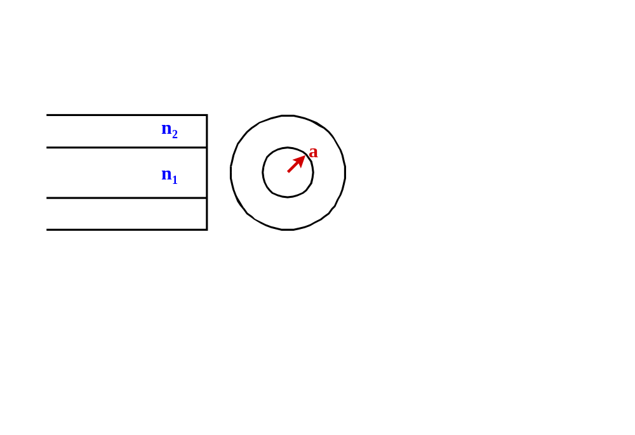
FIBER STRUCTURE
Main parameters
  Core’s size, radius “a”
  Cladding’s refractive index n₂
  Core’s refractive index n₁ , or n₁(r) if it varies
Notes:
PESO
- Menos de la décima parte que coaxial
INCONVENIENTES
- No es capaz de llevar la alimentación (como hace el coaxial)

Slide 35
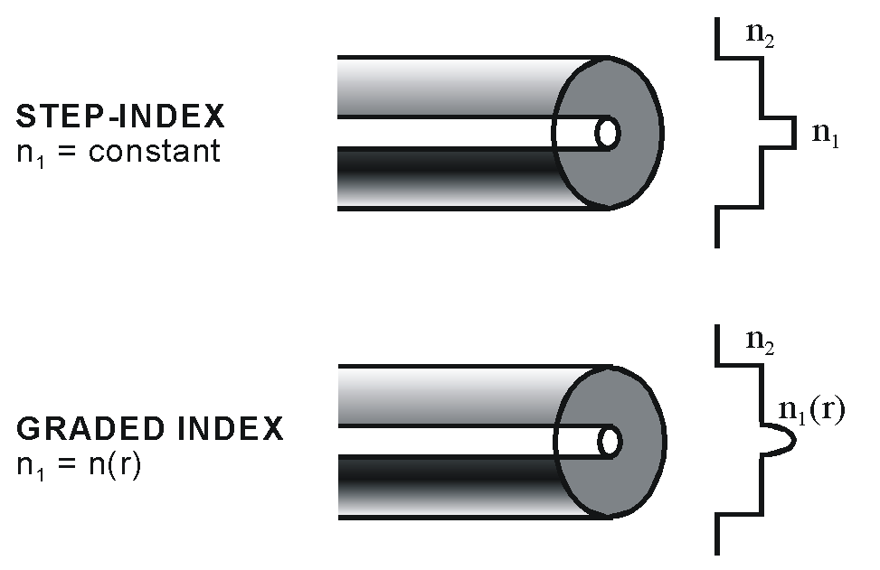
FIBER STRUCTURE
Fiber types
Notes:
PESO
- Menos de la décima parte que coaxial
INCONVENIENTES
- No es capaz de llevar la alimentación (como hace el coaxial)

Slide 36
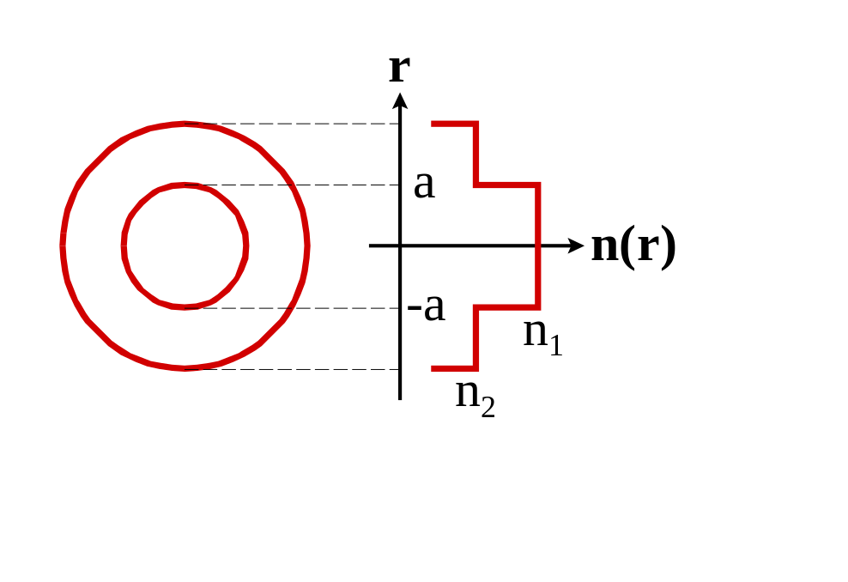
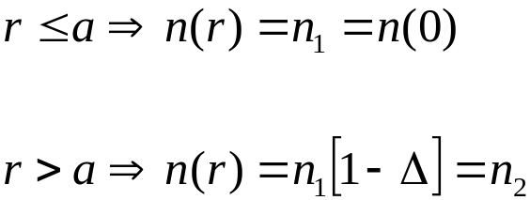
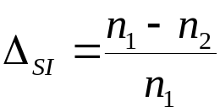
FIBER STRUCTURE
Step-Index Fiber
  n₂ = constant (cladding)
  n₁ = constant (core)
  Relative Index Difference
Typical values (SiO₂):
n₁ ≈ 1.461
n₂ ≈ 1.460
Δ_{SI} = 0.01-0.05
Notes:
PESO
- Menos de la décima parte que coaxial
INCONVENIENTES
- No es capaz de llevar la alimentación (como hace el coaxial)

Slide 37
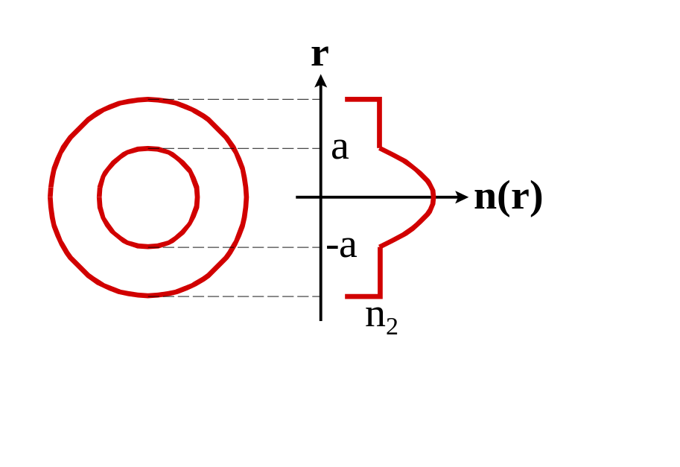
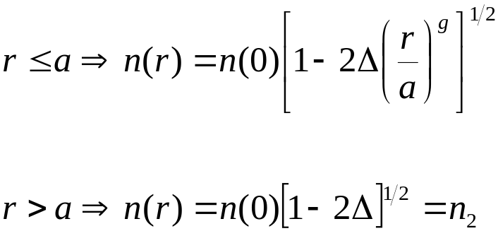
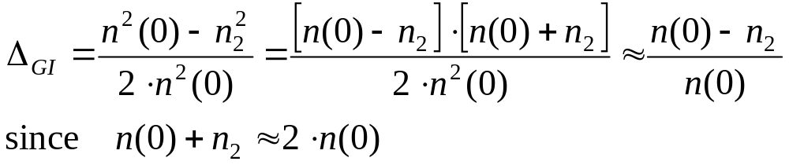
FIBER STRUCTURE
Graded Index Fiber
  n₂ = constant (cladding)
  n₁ = n(r) variable! (core)
  Relative Index Difference
Notes:
PESO
- Menos de la décima parte que coaxial
INCONVENIENTES
- No es capaz de llevar la alimentación (como hace el coaxial)

Slide 38
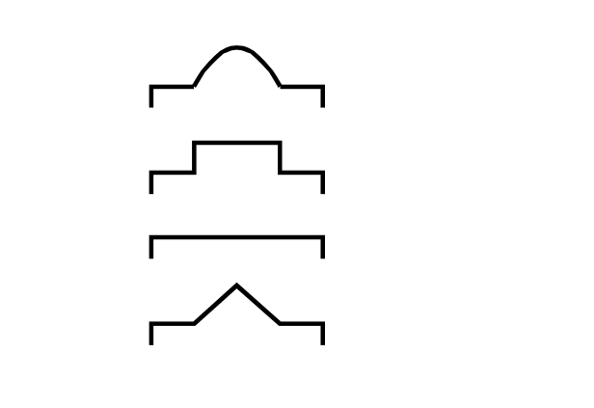
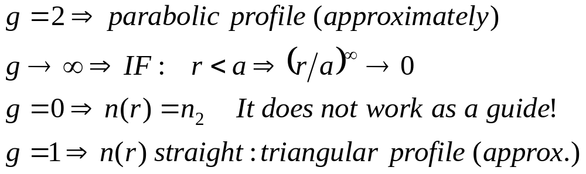
FIBER STRUCTURE
  Index profile parameter “g”
  Most important values
    Step-Index fiber: g → ∞
    Graded index fiber: g ≈ 2
Notes:
PESO
- Menos de la décima parte que coaxial
INCONVENIENTES
- No es capaz de llevar la alimentación (como hace el coaxial)

Slide 39
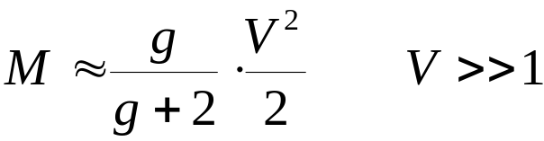
WAVES
Modal Theory
  Maxwell eqs. Wave eqs. MODES
  MODES: different ways for light to propagate
  Number of solutions —depends on
    n₁, n₂
    λ
    a (core radius), diameter Ø = 2a
    Approximate expression
medium
solutions
Be careful! This is an approximation, M is discrete
Notes:
PESO
- Menos de la décima parte que coaxial
INCONVENIENTES
- No es capaz de llevar la alimentación (como hace el coaxial)

Slide 40
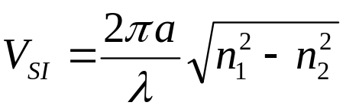
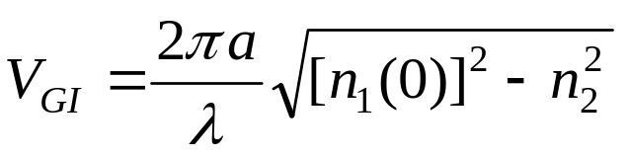
WAVES
    g: constant which appears in refractive profile n₁(r)
      g ∈ (0,∞)
      Usually g ≥ 1
    V: “Normalized Frequency”. It appears in Maxwell equations
  Fiber types: according to the number of propagating modes
    SINGLE-MODE: M = 1
    MULTIMODE: M > 1
SI: Step Index
GI: Graded Index
Notes:
PESO
- Menos de la décima parte que coaxial
INCONVENIENTES
- No es capaz de llevar la alimentación (como hace el coaxial)

Slide 41


WAVES
    How is M controlled?
      g/(g+2): varies little
        g = 1 ⇒ 1/3
        g = ∞ ⇒ 1
      λ: varies little (fiber only propagates
      light in a narrow window)
      (n₁²-n₂²)^{1/2}: varies little (technology)
    In particular: M = 1
      V_{SI} < 2.405 (g → ∞)
      V_{GI} < 3.518 (g = 2)
SO, THE KEY
PARAMETER IS “a”
a↓ ⇒ M = 1
a↑ ⇒ M > 1
Notes:
PESO
- Menos de la décima parte que coaxial
INCONVENIENTES
- No es capaz de llevar la alimentación (como hace el coaxial)

Slide 42

RAYS (III)
  Refractive index values
    To achieve total reflection in the interface ⇒ sin(θ_{i}) > n₂/n₁
    If n₂ > n₁ ⇒ θ_{i} / sin(θ_{i}) > n₂/n₁ > 1
    If n₂ = n₁ ⇒ there is no interface (ray escapes)
    Therefore: n₂ < n₁
Notes:
PESO
- Menos de la décima parte que coaxial
INCONVENIENTES
- No es capaz de llevar la alimentación (como hace el coaxial)

Slide 43


RAYS
Critical Angle —to propagate light
θ_{L}: limit angle of propagation
α_{OL}: limit angle of acceptance
Notes:
PESO
- Menos de la décima parte que coaxial
INCONVENIENTES
- No es capaz de llevar la alimentación (como hace el coaxial)

Slide 44


RAYS
Numerical Aperture
  Light capturing ability of the fiber
  Definition
  Step-Index Fiber
Notes:
PESO
- Menos de la décima parte que coaxial
INCONVENIENTES
- No es capaz de llevar la alimentación (como hace el coaxial)

Slide 45


RAYS
  Graded Index Fiber —same expression is applied
Notes:
PESO
- Menos de la décima parte que coaxial
INCONVENIENTES
- No es capaz de llevar la alimentación (como hace el coaxial)

Slide 46


RAYS
Ray Paths
  SI Fiber
    Straight line paths
    They all have the same velocity (n₁ constant)
  GI Fiber
    Curved trayectories
    Velocity changes: shorter paths travels more slowly
Notes:
PESO
- Menos de la décima parte que coaxial
INCONVENIENTES
- No es capaz de llevar la alimentación (como hace el coaxial)

Slide 47

RAYS
Rays & Modes
  A mode prefers a specific propagation angle
  Although modes and rays behave differently…
  For our purposes: one mode ≈ one ray
  Then, multimode ≈ multi-ray
Notes:
PESO
- Menos de la décima parte que coaxial
INCONVENIENTES
- No es capaz de llevar la alimentación (como hace el coaxial)

Slide 48


Slide 49


Slide 50


Slide 51


Slide 52


Slide 53


Slide 54


Slide 55
Theories of Optics
Light is an electromagentic phenomenon described by the same theoretical principles that govern all forms of electromagnetic radiation. Maxwell’s equations are in the hurt of electromagnetic theory & is fully successful in providing treatment of light propagation. Electromagnetic optics provides the most complete treatment of light phenomena in the context of classical optics.
Turning to phenomena involving the interaction of light & matter, such as emission & absorption of light, quantum theory provides the successful explanation for light-matter interaction. These phenomena are described by quantum electrodynamics which is the marriage of electromagnetic theory with quantum theory. For optical phenomena, this theory also referred to as quantum optics. This theory provides an explanation of virtually all optical phenomena.

Slide 56
In the context of classical optics, electromagentic radiation propagates in the form of two mutually coupled vector waves, an electric field-wave & magnetic field wave. It is possible to describe many optical phenomena such as diffraction, by scalar wave theory in which light is described by a single scalar wavefunction. This approximate theory is called scalar wave optics or simply wave optics. When light propagates through & around objects whose dimensions are much greater than the optical wavelength, the wave nature of light is not readily discerned, so that its behavior can be adequately described by rays obeying a set of geometrical rules. This theory is called ray optics. Ray optics is the limit of wave optics when the wavelength is very short.
Quantum Optics
Electromagnetic Optics
Wave Optics
Ray Optics

Slide 57
Engineering Model
In engineering discipline, we should choose the appropriate & easiest physical theory that can handle our problems. Therefore, specially in this course we will use different optical theories to describe & analyze our problems. In this chapter we deal with optical transmission through fibers, and other optical waveguiding structures. Depending on the structure, we may use ray optics or electromagnetic optics, so we begin our discussion with a brief introduction to electromagnetic optics, ray optics & their fundamental connection, then having equipped with basic theories, we analyze the propagation of light in the optical fiber structures.

Slide 58

Electromagnetic Optics
Electromagnetic radiation propagates in the form of two mutually coupled vector waves, an electric field wave & a magnetic field wave. Both are vector functions of position & time.
In a source-free, linear, homogeneous, isotropic & non-dispersive media, such as free space, these electric & magnetic fields satisfy the following partial differential equations, known as Maxwell’ equations:
[2-1]
[2-2]
[2-3]
[2-4]

Slide 59


In Maxwell’s equations, E is the electric field expressed in [V/m], H is the magnetic field expressed in [A/m].
The solution of Maxwell’s equations in free space, through the wave equation, can be easily obtained for monochromatic electromagnetic wave. All electric & magnetic fields are harmonic functions of time of the same frequency. Electric & magnetic fields are perpendicular to each other & both perpendicular to the direction of propagation, k, known as transverse wave (TEM). E, H & k form a set of orthogonal vectors.

Slide 60
Electromagnetic Plane wave in Free space
E
x
Direction of Propagation
k
x
z
z
y
B
y
An electromagnetic wave is a travelling wave which has time
varying electric and magnetic fields which are perpendicular to each
other and the direction of propagation,
z.
S.O.Kasap, optoelectronics and Photonics Principles and Practices, prentice hall, 2001

Slide 61

Linearly Polarized Electromagnetic Plane wave
[2-5]
[2-6]
Angular frequency [rad/m]
[2-7]
Wavenumber or wave propagation constant [1/m]
Wavelength [m]
intrinsic (wave) impedance
[2-8]
velocity of wave propagation
[2-9]

Slide 62
E
and
B
have constant phase
in this
xy
plane; a wavefront
z
E
E
k
B
Propagation
E
x
E
=
E
sin(
ω
t–kz
)
x
o
z
A plane EM wave travelling along
z
, has the same
E
x
(or
B
y
) at any point in a
given
xy
plane. All electric field vectors in a given
xy
plane are therefore in phase.
The
xy
planes are of infinite extent in the
x
and
y
directions.
S.O.Kasap, optoelectronics and Photonics Principles and Practices, prentice hall, 2001

Slide 63



Wavelength & free space
Wavelength is the distance over which the phase changes by .
In vacuum (free space):
[2-10]
[2-11]

Slide 64



EM wave in Media
Refractive index of a medium is defined as:
For non-magnetic media :
[2-12]
Relative magnetic permeability
Relative electric permittivity
[2-13]

Slide 65


Intensity & power flow of TEM wave
The poynting vector for TEM wave is parallel to the
wavevector k so that the power flows along in a direction normal to the wavefront or parallel to k. The magnitude of the poynting vector is the intensity of TEM wave as follows:
[2-14]

Slide 66
Connection between EM wave optics & Ray optics
According to wave or physical optics viewpoint, the EM waves radiated by a small optical source can be represented by a train of spherical wavefronts with the source at the center. A wavefront is defined a s the locus of all points in the wave train which exhibit the same phase. Far from source wavefronts tend to be in a plane form. Next page you will see different possible phase fronts for EM waves.
When the wavelength of light is much smaller than the object, the wavefronts appear as straight lines to this object. In this case the light wave can be indicated by a light ray, which is drawn perpendicular to the phase front and parallel to the Poynting vector, which indicates the flow of energy. Thus, large scale optical effects such as reflection & refraction can be analyzed by simple geometrical process called ray tracing. This view of optics is referred to as ray optics or geometrical optics.

Slide 67
Wave fronts
(constant phase surfaces)
Wave fronts
Wave fronts
k
λ
λ
P
E
rays
k
r
P
λ
O
z
A perfect plane wave
A perfect spherical wave
A divergent beam
(a)
(b)
(c)
Examples of possible EM waves
S.O.Kasap, optoelectronics and Photonics Principles and Practices, prentice hall, 2001

Slide 68


General form of linearly polarized plane waves
Any two orthogonal plane waves
Can be combined into a linearly
Polarized wave. Conversely, any
arbitrary linearly polarized wave
can be resolved into two
independent Orthogonal plane
waves that are in phase.
[2-15]
Optical Fiber communications, 3rd ed.,G.Keiser,McGrawHill, 2000

Slide 69


Elliptically Polarized plane waves
[2-16]
Optical Fiber communications, 3rd ed.,G.Keiser,McGrawHill, 2000

Slide 70


Circularly polarized waves
[2-17]
Optical Fiber communications, 3rd ed.,G.Keiser,McGrawHill, 2000

Slide 71


Laws of Reflection & Refraction
Reflection law: angle of incidence=angle of reflection
Snell’s law of refraction:
[2-18]
Optical Fiber communications, 3rd ed.,G.Keiser,McGrawHill, 2000

Slide 72












Total internal reflection, Critical angle
Transmitted
(refracted) light
k
t
n
Evanescent wave
2
n
1
>
n
2
k
k
i
r
TIR
Incident
Critical angle
Reflected
light
light
(
a
)
(
b
)
(
c
)
Light wave travelling in a more dense medium strikes a less dense medium. Depending on
the incidence angle with respect to
, which is determined by the ratio of the refractive
indices, the wave may be transmitted (refracted) or reflected. (a)
(b)
(c)
and total internal reflection (TIR).
[2-19]

Slide 73

Phase shift due to TIR
The totally reflected wave experiences a phase shift however which is given by:
Where (p,N) refer to the electric field components parallel or normal to the plane of incidence respectively.
[2-20]

Slide 74

Optical waveguiding by TIR:
Dielectric Slab Waveguide
Propagation mechanism in an ideal step-index optical waveguide.
Optical Fiber communications, 3rd ed.,G.Keiser,McGrawHill, 2000

Slide 75




Launching optical rays to slab waveguide
[2-21]
Maximum entrance angle, is found from
the Snell’s relation written at the fiber end face.
[2-22]
Numerical aperture:
[2-23]
[2-24]

Slide 76




Optical rays transmission through dielectric slab waveguide
O
For TE-case, when electric waves are normal to the plane of incidence
must be satisfied with following relationship:
[2-25]
Optical Fiber communications, 3rd ed.,G.Keiser,McGrawHill, 2000

Slide 77

Note
Home work 2-1) Find an expression for ,considering that the electric field component of optical wave is parallel to the plane of incidence (TM-case).
As you have seen, the polarization of light wave down the slab waveguide changes the condition of light transmission. Hence we should also consider the EM wave analysis of EM wave propagation through the dielectric slab waveguide. In the next slides, we will introduce the fundamental concepts of such a treatment, without going into mathematical detail. Basically we will show the result of solution to the Maxwell’s equations in different regions of slab waveguide & applying the boundary conditions for electric & magnetic fields at the surface of each slab. We will try to show the connection between EM wave and ray optics analyses.

Slide 78



EM analysis of Slab waveguide
For each particular angle, in which light ray can be faithfully transmitted along slab waveguide, we can obtain one possible propagating wave solution from a Maxwell’s equations or mode.
The modes with electric field perpendicular to the plane of incidence (page) are called TE (Transverse Electric) and numbered as:
Electric field distribution of these modes for 2D slab waveguide can be expressed as:
wave transmission along slab waveguides, fibers & other type of optical waveguides can be fully described by time & z dependency of the mode:
[2-26]

Slide 79


TE modes in slab waveguide
y
z
Optical Fiber communications, 3rd ed.,G.Keiser,McGrawHill, 2000

Slide 80

Modes in slab waveguide
The order of the mode is equal to the # of field zeros across the guide. The order of the mode is also related to the angle in which the ray congruence corresponding to this mode makes with the plane of the waveguide (or axis of the fiber). The steeper the angle, the higher the order of the mode.
For higher order modes the fields are distributed more toward the edges of the guide and penetrate further into the cladding region.
Radiation modes in fibers are not trapped in the core & guided by the fiber but they are still solutions of the Maxwell’ eqs. with the same boundary conditions. These infinite continuum of the modes results from the optical power that is outside the fiber acceptance angle being refracted out of the core.
In addition to bound & refracted (radiation) modes, there are leaky modes in optical fiber. They are partially confined to the core & attenuated by continuously radiating this power out of the core as they traverse along the fiber (results from Tunneling effect which is quantum mechanical phenomenon.) A mode remains guided as long as

Slide 81





Optical Fibers: Modal Theory (Guided or Propagating modes) & Ray Optics Theory
Optical Fiber communications, 3rd ed.,G.Keiser,McGrawHill, 2000
Step Index Fiber

Slide 82



Modal Theory of Step Index fiber
General expression of EM-wave in the circular fiber can be written as:
Each of the characteristic solutions is called mth mode of the optical fiber.
It is often sufficient to give the E-field of the mode.
[2-27]

Slide 83




The modal field distribution, , and the mode propagation constant, are obtained from solving the Maxwell’s equations subject to the boundary conditions given by the cross sectional dimensions and the dielectric constants of the fiber.
Most important characteristics of the EM transmission along the fiber are determined by the mode propagation constant, , which depends on the mode & in general varies with frequency or wavelength. This quantity is always between the plane propagation constant (wave number) of the core & the cladding media .
[2-28]

Slide 84


At each frequency or wavelength, there exists only a finite number of guided or propagating modes that can carry light energy over a long distance along the fiber. Each of these modes can propagate in the fiber only if the frequency is above the cut-off frequency, , (or the source wavelength is smaller than the cut-off wavelength) obtained from cut-off condition that is:
To minimize the signal distortion, the fiber is often operated in a single mode regime. In this regime only the lowest order mode (fundamental mode) can propagate in the fiber and all higher order modes are under cut-off condition (non-propagating).
Multi-mode fibers are also extensively used for many applications. In these fibers many modes carry the optical signal collectively & simultaneously.
[2-29]

Slide 85


Fundamental Mode Field Distribution
Mode field diameter
Polarizations of fundamental mode
Optical Fiber communications, 3rd ed.,G.Keiser,McGrawHill, 2000

Slide 86

Ray Optics Theory (Step-Index Fiber)
Skew rays
Each particular guided mode in a fiber can be represented by a group of rays which
Make the same angle with the axis of the fiber.
Optical Fiber communications, 3rd ed.,G.Keiser,McGrawHill, 2000

Slide 87

Different Structures of Optical Fiber
Optical Fiber communications, 3rd ed.,G.Keiser,McGrawHill, 2000

Slide 88




Mode designation in circular cylindrical waveguide (Optical Fiber)
The electric field vector lies in transverse plane.
The magnetic field vector lies in transverse plane.
TE component is larger than TM component.
TM component is larger than TE component.
y
l= # of variation cycles or zeros in direction.
m= # of variation cycles or zeros in r direction.
r
x
z
Linearly Polarized (LP) modes in weakly-guided fibers ( )
Fundamental Mode:

Slide 89

Two degenerate fundamental modes in Fibers (Horizontal & Vertical Modes)
Optical Fiber communications, 3rd ed.,G.Keiser,McGrawHill, 2000

Slide 90




Mode propagation constant as a function of frequency
Mode propagation constant, , is the most important transmission characteristic of an optical fiber, because the field distribution can be easily written in the form of eq. [2-27].
In order to find a mode propagation constant and cut-off frequencies of various modes of the optical fiber, first we have to calculate the normalized frequency, V, defined by:
[2-30]
a: radius of the core, is the optical free space wavelength,
are the refractive indices of the core & cladding.

Slide 91

Plots of the propagation constant as a function of normalized frequency for a few of the lowest-order modes

Slide 92


Single mode Operation
The cut-off wavelength or frequency for each mode is obtained from:
Single mode operation is possible (Single mode fiber) when:
[2-31]
[2-32]

Slide 93



Single-Mode Fibers
Example: A fiber with a radius of 4 micrometer and
has a normalized frequency of V=2.38 at a wavelength 1 micrometer. The fiber is single-mode for all wavelengths greater and equal to 1 micrometer.
MFD (Mode Field Diameter): The electric field of the first fundamental mode can be written as:
[2-33]

Slide 94


Birefringence in single-mode fibers
Because of asymmetries the refractive indices for the two degenerate modes (vertical & horizontal polarizations) are different. This difference is referred to as birefringence, :
[2-34]
Optical Fiber communications, 3rd ed.,G.Keiser,McGrawHill, 2000

Slide 95

Fiber Beat Length
In general, a linearly polarized mode is a combination of both of the degenerate modes. As the modal wave travels along the fiber, the difference in the refractive indices would change the phase difference between these two components & thereby the state of the polarization of the mode. However after certain length referred to as fiber beat length, the modal wave will produce its original state of polarization. This length is simply given by:
[2-35]

Slide 96



Multi-Mode Operation
Total number of modes, M, supported by a multi-mode fiber is approximately (When V is large) given by:
Power distribution in the core & the cladding: Another quantity of interest is the ratio of the mode power in the cladding, to the total optical power in the fiber, P, which at the wavelengths (or frequencies) far from the cut-off is given by:
[2-36]
[2-37]

